Slide 1


Forecasting world population
Emil Chmielewski

Slide 2
Issues with dataset
USA’s 2020 census cost $14.2 bilion
Usually, a census is performed once per 10 years
Latest data for some countries is from 2006
Not everybody is counted
We have semi-reliable data from 1950, only 72 years

Slide 3



Possible variables
=
-
Number of fertile women
Women’s education level
Government support
Government’s policies
Level of medical care
Average income
Stability and safety of a country
…

Slide 4
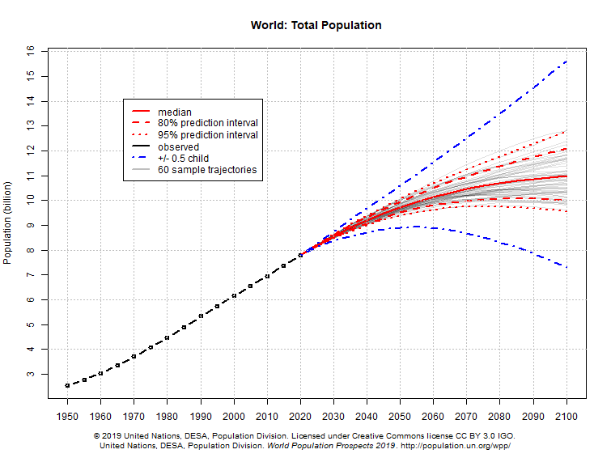
United Nation’s predictions

Slide 5
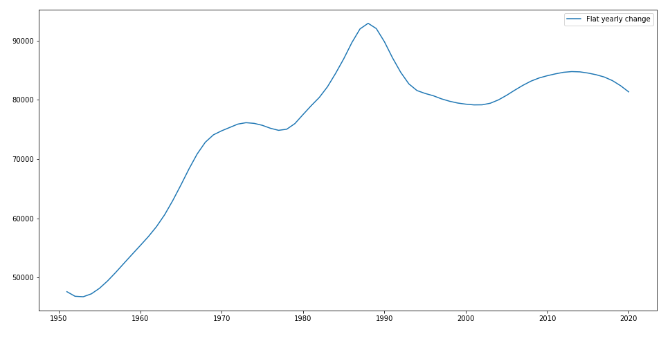
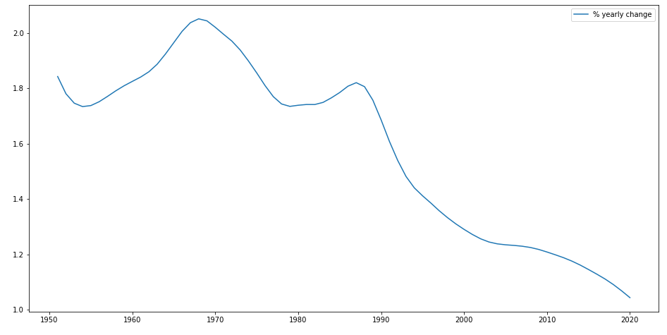
Different views
Flat yearly increase in population (in thousands)
% yearly increase in population

Slide 6
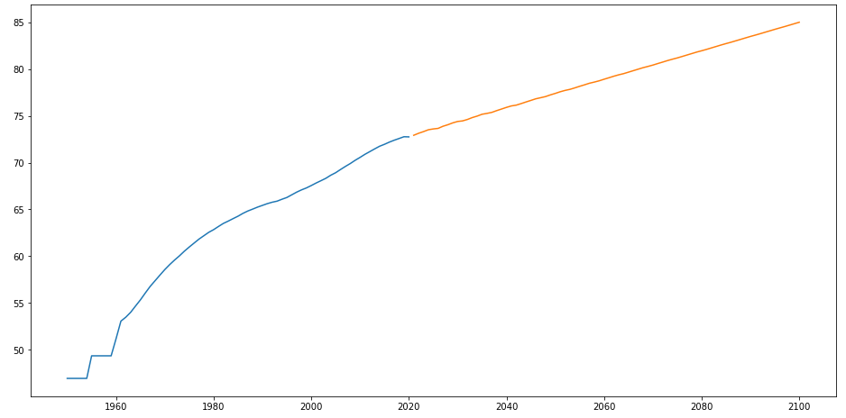
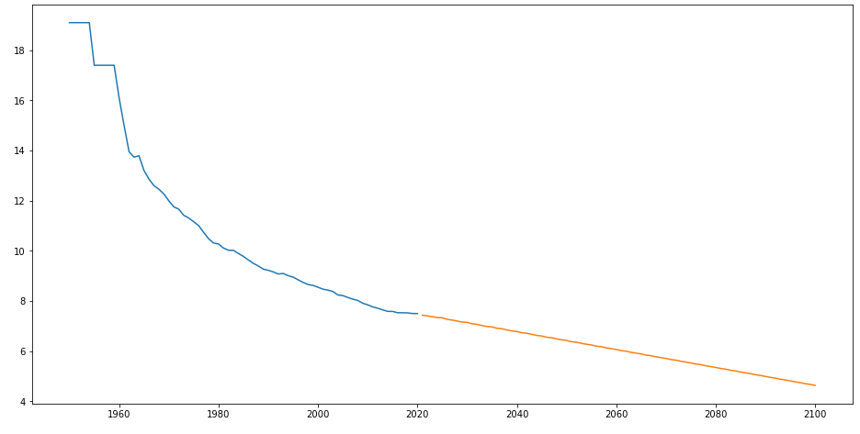
Forecasting exogeneus variables
Life expectancy
Crude deaths (# of deaths per 1000 people)

Slide 7
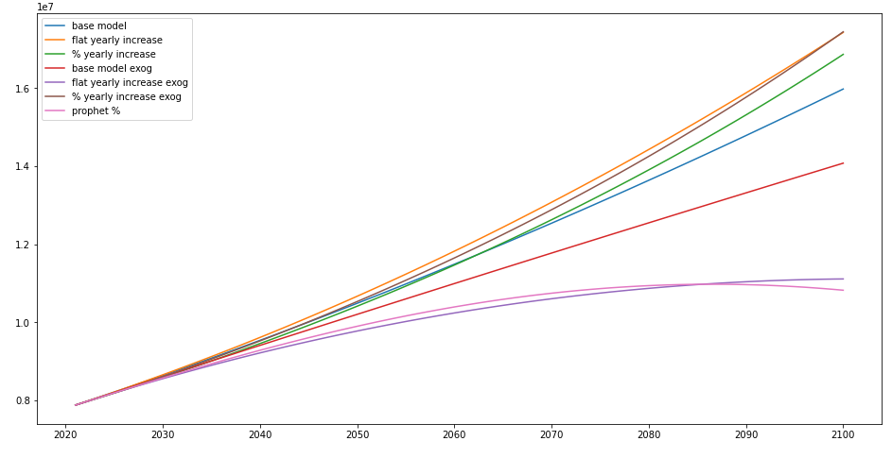
My forecast

Slide 8
Thank you for listening!

